Slide 1
Design and Analysis of Algorithms
Algorithms-II : CS345A
Website: hello.iitk.ac.in
Lecture 9
Proof of Correctness - II

Slide 2
Topological Numbering of a DAG

Slide 3



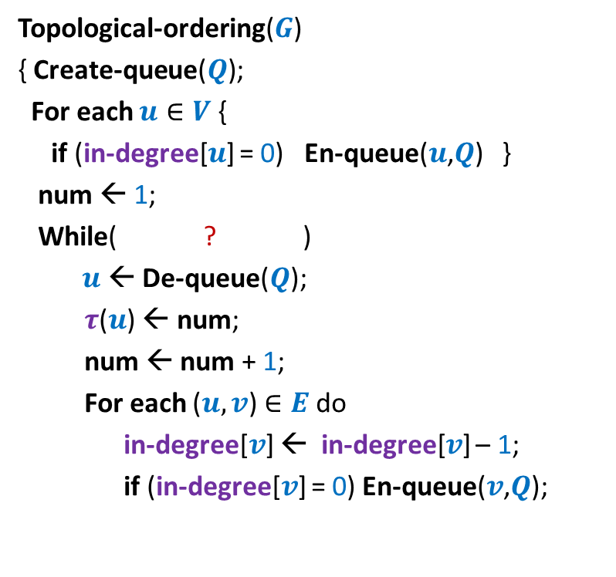




Algorithm for Topological ordering ?
Topological-ordering($G$)
{ Create-queue($Q$);
For each $u∈V$ {
if (in-degree[$u$] = 0) En-queue($u$,$Q$) }
num ← 1;
While( ? )
$u$← De-queue($Q$);
$τ$($u$) ← num;
num ← num + 1;
For each ($u,v$) $∈E$ do
in-degree[$v$] ← in-degree[$v$] – 1;
if (in-degree[$v$] = 0) En-queue($v$,$Q$);
Assertion 1:
For each ($x$,$y$) $∈E$, $τ$($x$) $<τ$($y$).
For each vertex $u$,
not-empty($Q$)
{
In-degree[$u$] ← 0
En-queue($u$, $Q$);
What is the order in which these 2 events happen ?
{
?
$u$← De-queue($Q$);
}
$τ$($u$) ← num;
} return $τ$ ;
}

Slide 4
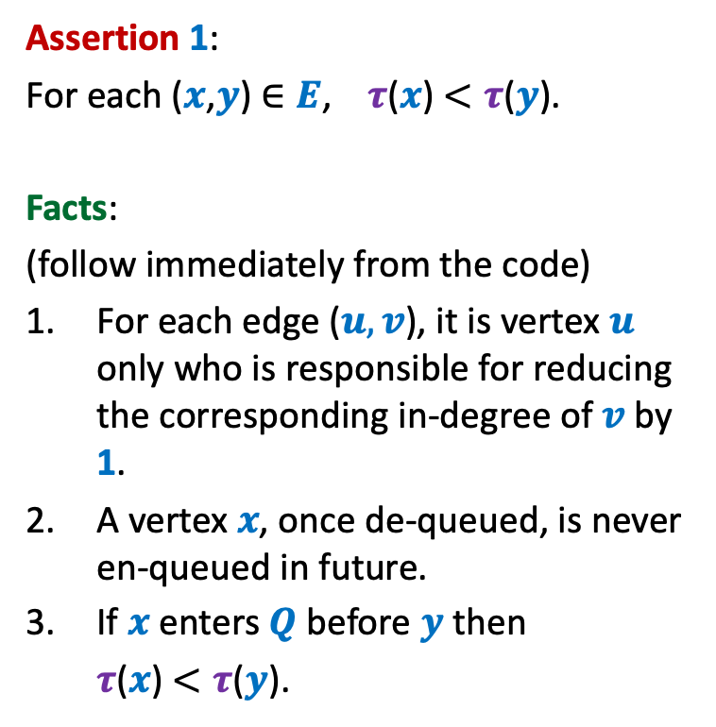
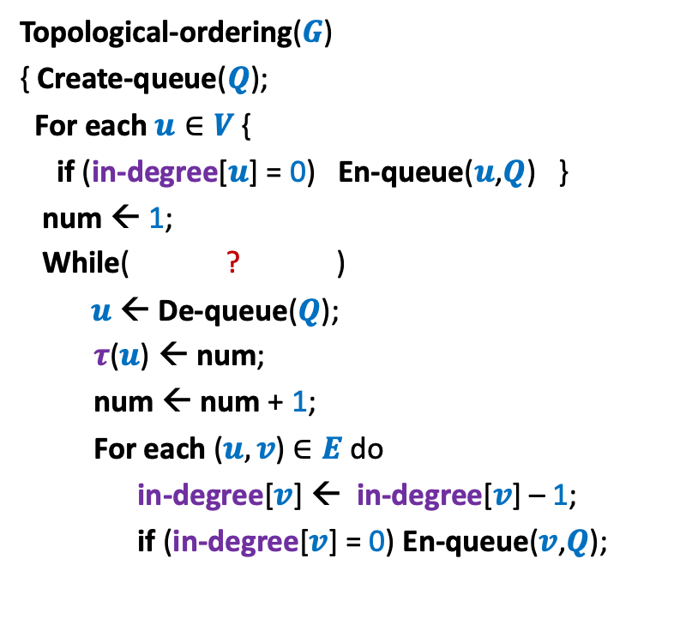
Algorithm for Topological ordering ?
Topological-ordering($G$)
{ Create-queue($Q$);
For each $u∈V$ {
if (in-degree[$u$] = 0) En-queue($u$,$Q$) }
num ← 1;
While( ? )
$u$← De-queue($Q$);
$τ$($u$) ← num;
num ← num + 1;
For each ($u,v$) $∈E$ do
in-degree[$v$] ← in-degree[$v$] – 1;
if (in-degree[$v$] = 0) En-queue($v$,$Q$);
Assertion 1:
For each ($x$,$y$) $∈E$, $τ$($x$) $<τ$($y$).
Facts:
(follow immediately from the code)
For each edge ($u,v$), it is vertex $u$ only who is responsible for reducing the corresponding in-degree of $v$ by 1.
A vertex $x$, once de-queued, is never en-queued in future.
If $x$ enters $Q$ before $y$ then
$τ$($x$) $<τ$($y$).
not-empty($Q$)
{
{
}
A vertex is enqueued only after its in-degree becomes 0. So it is enqueued at most once.
} return $τ$ ;
Due to FIFO nature of Queue
}

Slide 5





Algorithm for Topological ordering ?
Topological-ordering($G$)
{ Create-queue($Q$);
For each $u∈V$ {
if (in-degree[$u$] = 0) En-queue($u$,$Q$) }
num ← 1;
While( ? )
$u$← De-queue($Q$);
$τ$($u$) ← num;
num ← num + 1;
For each ($u,v$) $∈E$ do
in-degree[$v$] ← in-degree[$v$] – 1;
if (in-degree[$v$] = 0) En-queue($v$,$Q$);
Assertion 1:
For each ($x$,$y$) $∈E$, $τ$($x$) $<τ$($y$).
En-queue($x$, $Q$);
not-empty($Q$)
{
$x$← De-queue($Q$);
{
In-degree[$y$] ← 0
En-queue($y$, $Q$);
}
} return $τ$ ;
}

Slide 6


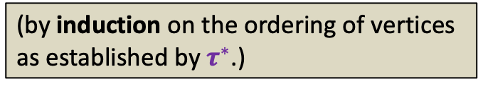
Algorithm for Topological ordering ?
Topological-ordering($G$)
{ Create-queue($Q$);
For each $u∈V$ {
if (in-degree[$u$] = 0) En-queue($u$,$Q$) }
num ← 1;
While( ? )
$u$← De-queue($Q$);
$τ$($u$) ← num;
num ← num + 1;
For each ($u,v$) $∈E$ do
in-degree[$v$] ← in-degree[$v$] – 1;
if (in-degree[$v$] = 0) En-queue($v$,$Q$);
Assertion 1:
For each ($x$,$y$) $∈E$, $τ$($x$) $<τ$($y$).
Assertion 2:
For each $x∈V$, $τ$($x$) is assigned a
number.
Proof:
Let $τ^{∗}$ be any topological numbering of
vertices of $G$.
Are we done ?
not-empty($Q$)
{
No.
What is the guarantee that $τ$($x$) is assigned a number during the algorithm.
{
(by induction on the ordering of vertices
as established by $τ^{∗}$.)
}
} return $τ$ ;
}

Slide 7


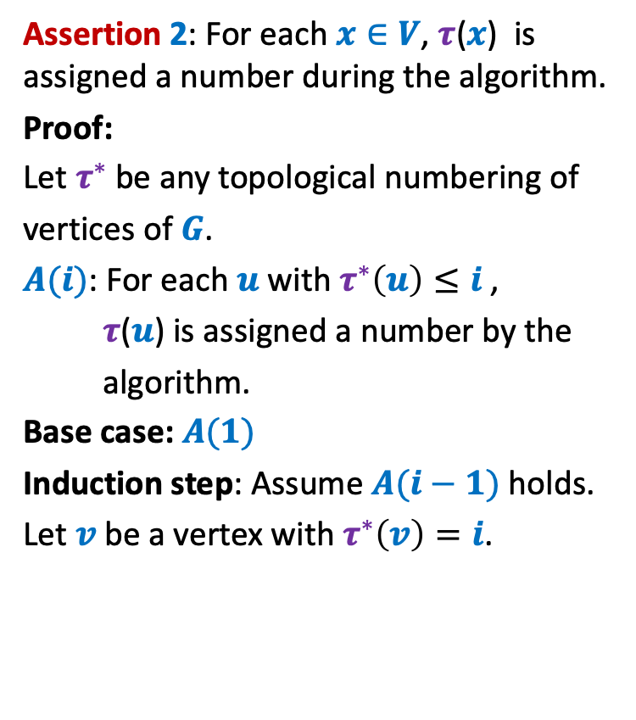



Algorithm for Topological ordering ?
Assertion 2: For each $x∈V$, $τ$($x$) is assigned a number during the algorithm.
Proof:
Let $τ^{∗}$ be any topological numbering of
vertices of $G$.
$A(i)$: For each $u$ with $τ^{∗}\left(u\right)≤i$ ,
$τ$($u$) is assigned a number by the
algorithm.
Base case: $A(1)$
Induction step: Assume $A(i−1)$ holds.
Let $v$ be a vertex with $τ^{∗}\left(v\right)=i$.
Topological-ordering($G$)
{ Create-queue($Q$);
For each $u∈V$ {
if (in-degree[$u$] = 0) En-queue($u$,$Q$) }
num ← 1;
While( ? )
$u$← De-queue($Q$);
$τ$($u$) ← num;
num ← num + 1;
For each ($u,v$) $∈E$ do
in-degree[$v$] ← in-degree[$v$] – 1;
if (in-degree[$v$] = 0) En-queue($v$,$Q$);
not-empty($Q$)
{
{
}
$$u$$
$$v$$
} return $τ$ ;
}
In-degree[$v$] ← 0
En-queue($v$, $Q$);

Slide 8

Algorithm for Topological ordering ?
Assertion 2: For each $x∈V$, $τ$($x$) is assigned a number during the algorithm.
Proof:
Let $τ^{∗}$ be any topological numbering of
vertices of $G$.
$A(i)$: For each $u$ with $τ^{∗}\left(u\right)≤i$ ,
$τ$($u$) is assigned a number by the
algorithm.
Base case: $A(1)$
Induction step: Assume $A(i−1)$ holds.
Let $v$ be a vertex with $τ^{∗}\left(v\right)=i$.
Topological-ordering($G$)
{ Create-queue($Q$);
For each $u∈V$ {
if (in-degree[$u$] = 0) En-queue($u$,$Q$) }
num ← 1;
While( ? )
$u$← De-queue($Q$);
$τ$($u$) ← num;
num ← num + 1;
For each ($u,v$) $∈E$ do
in-degree[$v$] ← in-degree[$v$] – 1;
if (in-degree[$v$] = 0) En-queue($v$,$Q$);
not-empty($Q$)
{
{
}
$$u$$
$$v$$
} return $τ$ ;
}
In-degree[$v$] ← 0
En-queue($u$, $Q$);

Slide 9

Algorithm for Topological ordering ?
Assertion 2: For each $x∈V$, $τ$($x$) is assigned a number during the algorithm.
Assertion 1:
For each ($x$,$y$) $∈E$, $τ$($x$) $<τ$($y$).
Theorem:
Topological-ordering($G$) assigns a valid
topological numbering to all vertices of
the DAG $G$.
Topological-ordering($G$)
{ Create-queue($Q$);
For each $u∈V$ {
if (in-degree[$u$] = 0) En-queue($u$,$Q$) }
num ← 1;
While( ? )
$u$← De-queue($Q$);
$τ$($u$) ← num;
num ← num + 1;
For each ($u,v$) $∈E$ do
in-degree[$v$] ← in-degree[$v$] – 1;
if (in-degree[$v$] = 0) En-queue($v$,$Q$);
not-empty($Q$)
{
{
}
} return $τ$ ;
}

Slide 10
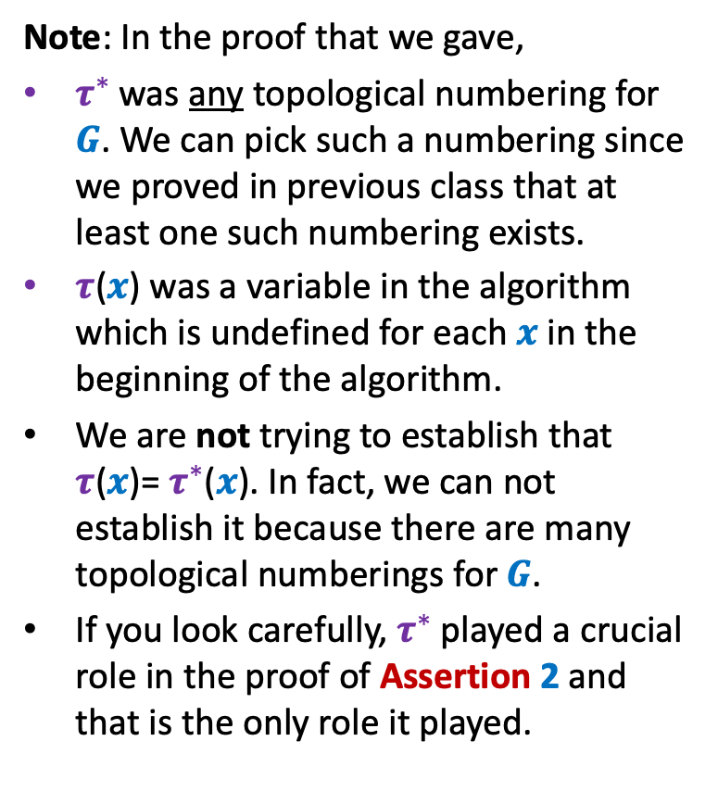
Algorithm for Topological ordering ?
Topological-ordering($G$)
{ Create-queue($Q$);
For each $u∈V$ {
if (in-degree[$u$] = 0) En-queue($u$,$Q$) }
num ← 1;
While( ? )
$u$← De-queue($Q$);
$τ$($u$) ← num;
num ← num + 1;
For each ($u,v$) $∈E$ do
in-degree[$v$] ← in-degree[$v$] – 1;
if (in-degree[$v$] = 0) En-queue($v$,$Q$);
Note: In the proof that we gave,
$τ^{∗}$ was any topological numbering for $G$. We can pick such a numbering since we proved in previous class that at least one such numbering exists.
$τ$($x$) was a variable in the algorithm which is undefined for each $x$ in the beginning of the algorithm.
We are not trying to establish that $τ$($x$)= $τ^{∗}$($x$). In fact, we can not establish it because there are many topological numberings for $G$.
If you look carefully, $τ^{∗}$ played a crucial role in the proof of Assertion 2 and that is the only role it played.
not-empty($Q$)
{
{
}
} return $τ$ ;
}

Slide 11
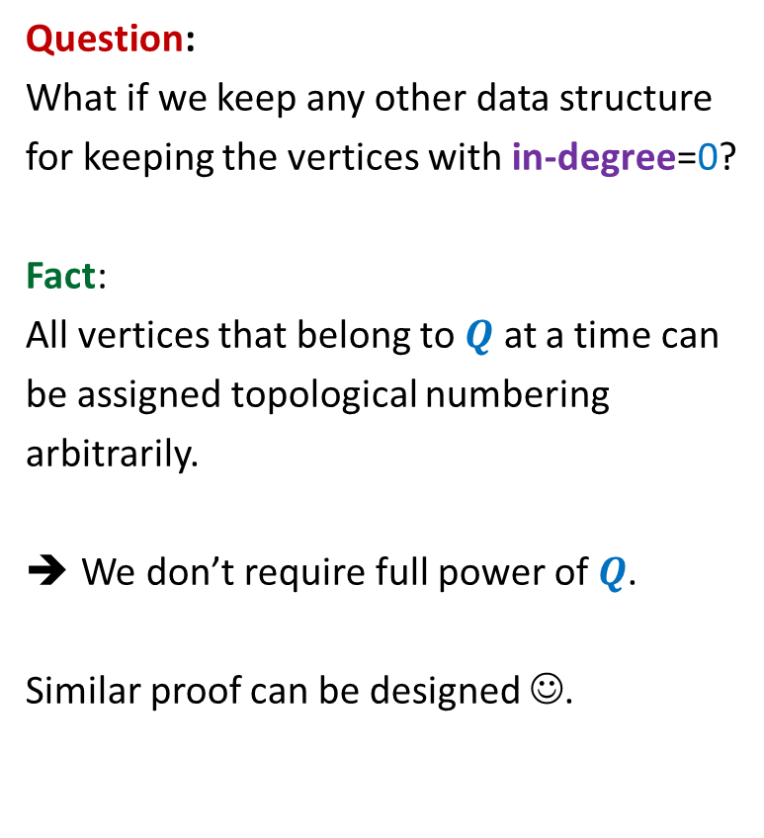
Algorithm for Topological ordering ?
Topological-ordering($G$)
{ Create-queue($Q$);
For each $u∈V$ {
if (in-degree[$u$] = 0) En-queue($u$,$Q$) }
num ← 1;
While( ? )
$u$← De-queue($Q$);
$τ$($u$) ← num;
num ← num + 1;
For each ($u,v$) $∈E$ do
in-degree[$v$] ← in-degree[$v$] – 1;
if (in-degree[$v$] = 0) En-queue($v$,$Q$);
Question:
What if we keep any other data structure
for keeping the vertices with in-degree=0?
Fact:
All vertices that belong to $Q$ at a time can
be assigned topological numbering
arbitrarily.
We don’t require full power of $Q$.
Similar proof can be designed ☺.
not-empty($Q$)
{
{
}
} return $τ$ ;
}

Slide 12
Proof of Correctness

Slide 13
Divide and Conquer Algorithm
Proof:
(By induction on the size of the problem)
Assume using I.H. that the algorithm for recursive calls
returns correct solution.
2. Just focus on the divide and combine step.

Slide 14
A Job scheduling problem

Slide 15





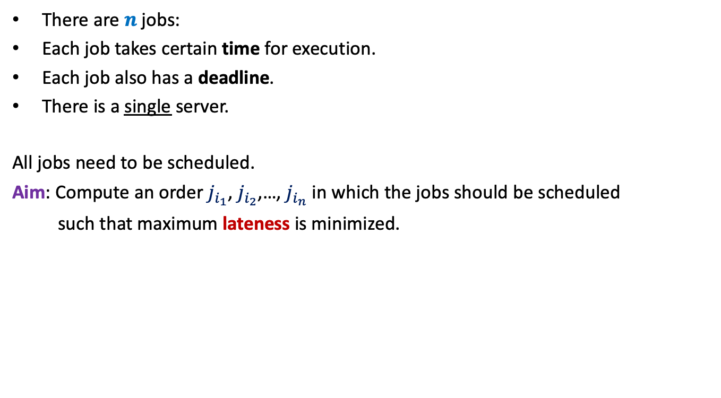








There are $n$ jobs:
Each job takes certain time for execution.
Each job also has a deadline.
There is a single server.
All jobs need to be scheduled.
Aim: Compute an order $j_{i_{1}}$, $j_{i_{2}}$,…, $j_{i_{n}}$ in which the jobs should be scheduled
such that maximum lateness is minimized.
$j_{1}$, $j_{2}$,…, $j_{n}$
Job $j_{i}$ takes $t_{i}$ time
Job $j_{i}$ has deadline $d_{i}$
$$f_{i_{k}}$$
$$d_{i_{k}}$$
$$d_{i_{k}}$$
Lateness of $j_{i_{k}}$
$$j_{i_{1}}$$
$$j_{i_{2}}$$
$$j_{i_{3}}$$
$$j_{i_{k}}$$
$$j_{i_{n}}$$
$$0$$
time

Slide 16













Example for a better understanding
$$t_{1}$$
$$j_{1}$$
$$d_{1}$$
$$t_{2}$$
$$j_{2}$$
$$d_{2}$$
$$t_{3}$$
Maximum lateness
$$j_{3}$$
$$d_{3}$$
$$j_{1}$$
$$j_{3}$$
$$j_{2}$$
time
$$0$$

Slide 17

Towards designing an algorithm
Each job $j_{i}$ has two parameters
Time of execution $t_{i}$
Deadline $d_{i}$
Idea 1: Schedule the jobs in the increasing order of Time of execution.
Try to prove correctness
Try to come up with a counter example
Let us try this first

